Slide 1
NSAA
Day reports

Slide 2
10/8/19
Zane - 13 rubber bands, 13 stonks. Deposited 150 wildcash
Harrison - 3 pencils 3 stonks
Rohat - 1 milk jug, 4 stonks

Slide 3
October 8th 2019 details
Zane : Rubber band to collin 1 stonk, Rubber band to simon, 1 stonk,2 Rubber bands to Asiana, 2 stonks, 2 rubber bands to dylan, two stonks Rubber band to Evan, one stonk. Rubber band to Nick, 1 stonk. Rubber band to jonah, 1 stonk. 3 Rubber bands to jesse, 3 stonks. Rubber band to Steven, 1 stonk.
Harrison: 1 pencil to random, one stonk. 1 pencil to Antia, one singular stonk. 1 pencil to Nathan. One stonky kong.
Rohat: one milk jug to Evan for four stonks

Slide 4
10/9/2019
Zane: Made 41 stonks from selling big bouncy balls for 3 stonks bouncy balls for 2 stonks and Rubber bands for 1 stonk. Mrs. Tatum’s counter cash wildcash sold to prabhav for 2 stonks’
Harrison: BAD
Rohat: Three RBs for three stonks
Ethan font was hired
Evan Farley was hired

Slide 5
October 10, 2019
Zane: 1 RB and earned 1 stonk
Jonah: 15 RBS and made 8 stonks for NSAA
Rest of Rubber Bands were given to carter
Harrison: one penCil and earned made 1 stonky kongy
Rahat: one rubber band for one stonkedy kongedy
Jonah was hired
Nick hoppe hired

Slide 6
October 11 , 2019
Zane: sold 2 bubble gums and one jolly rancher and made 3 stonks. Zane sold an empty bottle for one stonk.
Rahat: sold 2 pencils for two stonks and one jolly rancher for three stonks.
Harrison sold 2 pencils for 2 stonks

Slide 7
October 11 important info.
Andrew’s toys was founded on 10/10/19. They sell toys for wildcash. Only Andrew Santiago works there and he is leader.

Slide 8
October , 14 , 2019
No stonks were made.
NSAA mechanical pencil and pen pieces shop is now open.
The Co - Founder, Harrison was appointed item repair specialist.
The Geniral rahat was appointed head of banking and marketing.

Slide 9
October 15 2019
No stonks
The NSAA discord server was started

Slide 10
October 16 , 2019
Harrison: one paper finger headband to the Andrew and 1 stonk was made
The NSAA discord server rules started
No deleting messages ( yours or someone else’s)
No words in meme channel
No Nono words

Slide 11
October 17 2019
One pencil for one stonk

Slide 12
October 18 2019
Zane : 2 milk duds and one jolly rancher for 9 stonks

Slide 13
October 21 , 2019
Rahat: 2 stonks from band
Zane: three stonks from band, one cash from rainbow Patrick drawing
Project pencil launcher: get mechanical pencils to Zane miller so he can make pencil launchers. With the knowledge of the pencil launcher spreading Zane will break down mechanical pencils into value blue parts to sell for majestical stonks.
End of the year goals updated: stonks towards pieing mrs. Vest and leftovers to getting all of the mechanical pencils from the wildcat den.

Slide 14
October 22 , 2019
Zane: 3 pencil leads for 3 stonks to Jonah.
Attention: Tristin and Ishan are official enemies of the NSAA. Tristin is necking anyone in sight. And Ishan is stealing people’s lunchboxes and giving them to other people, who throw them in the trash. ( The many details is because it happened to me.) rip my poor lunchbox. Tristin’s necks include Necks, throats, Shreks and scissor necks. Rahat was recently almost killed by a supreme scissor neck and superb neck.

Slide 15
October 23 , 2019
Zane: a spring and a launcher ammo to Collin for 2 stonks
Harrison: one band for three and one pencil for one stonk.
Rahat: BAD

Slide 16
October 24 , 2019
Andrew gave Zane three mechanical pencils and now he is in debt four milk duds boxes.
Zane: pending deal with Jesse on a pencil launcher.

Slide 17
October 25 , 2019
Zane: pencil launcher to Jesse for 5 stonks, one gum to kid in advisory for 1 stonk
Rahat: 3 stonks from selling milk duds
Harrison: one tag for one stonk

Slide 18
October 28 , 2019
Milk duds were paid to Andrew for the mechanical pencils I was givin
Milk duds boxesX2 to Andrew for 10 wildcash

Slide 19
October 29 , 2019
Zane: sold 1 skeleton pen to Nick for 2 stonks, bought one SUPER bouncy ball from Andrew for 2 stonks but then sold a pencil to him for one stonk. One pencil to Thomas for one stonk. A profit of two stonks was created today.
Harrison: band for one stonk
The no necking treaty was created. Members will pay fines for necking people.

Slide 20
October 30 , 2019
ANDREW YEETED ZANE MILLER’s BOUNCY BALL OFF THE BALCONY AND NOW HE IS PAYING 10 STONKS FOR ANY ANDREW BRAND BOUNCY BALL.
Zane: one marker to Andrew for one stonk
Nick is in debt one stonk because I paid him one lead.
Harrison: tags for two stonks
Tristan was hired

Slide 21
October 31st 2019
Triston has been appointed spring department manager.
Zane: one pencil for one stonk

Slide 22
November 1 2019
Harrison: Three stonks lended to Powdered milk man
Zane: three stonks lended to powdered milk man.
David was hired
David invested 15 stonks
The Nono word policy was added to the no necking treaty. Members will get fined for saying Nono words

Slide 23
November 4 2019
No sales

Slide 24
November 6 2019
No stonks

Slide 25
November 7 2019
No sales

Slide 26
November 8 2019
Zane: one kit kat to collin for three stonks

Slide 27
November 11 2019
Zane: three type three mechanical pencil inerds to Dylan for three stonks. Pumpkin notepad to rahat for one wildcash
Important news
Mechanical Pencil classification is now a part of NSAA. Type one mechanical pencils are the papermate sharpwriters. They are non refillable andantes have twist top. Type two mechanical pencils are the pencil launcher supplies. They come in all colors and have pencil launcher ammo inside of them. Their casings are used as pencil launcher shells. Type three mechanical pencils are the breakable type. They have no way to remove the inerds without breaking the pencil casing. They have a long white, almost useless piece inside them for their inerds. Type four mechanical pencils are the clickable ones. The have a single pushable piece on the end that must be clicked to get lead. They are completely useless.

Slide 28
November 12 2019
Tristan: made ten stonks and gave five to community
Zane: sold a chocolate bar to Evan for two stonks

Slide 29
November 13 2019
Zane: Cheetos to Steven for two stonks
We have merged with enterprise incorporated.

Slide 30
November 13 2019 enterprise incorporated merge details
We have merged with enterprise incorporated. We are still separated company’s, but we have pooled our money and are going to pie mrs. Vest slime mrs. Vest and ducktape mrs. Vest. The community money of both company is now worth about 280 stonks or “wildcash” as enterprise incorporated says.

Slide 31
Important information we’ve discovered about enterprise incorporated.
After MSS fell at the end of last year, the remains of the fallen company influenced the new company of the 2019 - 2020 school year - enterprise incorporated. It is lead by Tyler. and steven and collin and kyrillos are the only known employees.

Slide 32
November 14 2019
Operation rabbit hole has been launched. Details are on the discord server.
Andrew donated 41 wildcash to NSAA.
We are now ally’s with Andrew’s toys.
End of year goals has been updated. We will pie mrs. Vest and then spend the rest of the wild cash on buying all the pencils from the wildcat den

Slide 33
November 15 2019
No stonks

Slide 34
November 18 2019
Tristan: 14 stonks

Slide 35
November 19 2019
Tristan: 2 stonks
David: 10 stonks

Slide 36
November 20 2019
Tristan: 2 stonks
Zane: pre ordered a bouncy ball from Andrew costing 10 stonks, sold Cheetos for 10 stonks, 1 starburst for 1 stonk one water for 3 stonks.

Slide 37
November 21 2019
Tristan: 2 wildcash

Slide 38
November 22 2019
Zane: one water for five wildcash
Tristan: 4 wildcash.

Slide 39
Dec 2 2019
No stonks
Operation rabbit hole was completed

Slide 40
Dec 3 2019
Zane: 16 stonks

Slide 41
Dec 4 2019
No stonks

Slide 42
Dec 5 2019
No stonks

Slide 43
Dec 6 2019
Zane: one stonk
Tristan: 5 stonks
Tyler: deposited 20 stonks

Slide 44
Dec 9 2019
Zane: 5 stonks
Project half cash is now an official fail.
Rahat ran into a pillar and almost died. we are now enemies with that pillar

Slide 45
Dec 10 2019
No stonks

Slide 46
Dec 11 2019
Zane: sold pencil for one stonk
Tristan: 3 stonks

Slide 47
Dec 12 2019
Tristan 5 stonks
Tristan has been promoted to general

Slide 48
Dec 13 2019
Zane: 20 stonks
Rahat was promoted to co Founder
The rules of promotions have been created
Person to general
Must get 50 promotion points and have confirmation from a co Founder . Promotion points are earned through giving stonks and sending memes.
General to Co Founder
Must have confirmation from all co founders

Slide 49
Dec 16 2019
David: four wildcash
Zane: one wildcash
Harrison: one stonkstonk for two wildcash

Slide 50
Dec 17 2019
Zane: one wildcash
Tristan: 3 wildcash
Rahat has started making sales again and agreed to make 100 wildcash and give us 50

Slide 51
Dec 18 2019
Zane: 15 wildcash
We now have 616 stonks
Project special collections has been founded by Zane Miller
Operation enhanced dirt has been founded by rahat
We are now collecting all rare and special cash including gen 1 cash dark cash counter cash and purple cash

Slide 52
Dec 19 2019
Zane: 1
Tyler: 23
Kyrillos: 2
Rahat: sold gum for two stonks and gave 1 stonk to community
A plan for operation enhanced dirt was made: Zane will not be attending the operation due to leaving early. Rahat and Tristan will find a stick and dig a small arm sized hole under fence. And reach in and rescue the ball that is worth 20 wildcash.
Rahat has started operation rainbow cash with jarad - theywill make a wildcash of every color

Slide 53
Dec 20 2019
No stonks
nick was hired his role is to create business ideas
Project special collections information: we have one dark cash four generation one wildcash one stonk stonk (wildcash with stonks printed on it) one wildwild ( two top halves of wildcash glued together) one cashcash ( two bottom halves of wildcash glued together) one countercash ( rare wildcash givin out one day by mrs. Tatum) and are currently working to get a purple cash.
Project associative recruitment program was founded by rahat. We are now searching for new members
Operation enchanted dirt failed due to not going outside

Slide 54
Jan 6 2020
Zane: one stonk
Tristan:10 stonks
Tyler: 121 stonks
Rahat: 3 gen one wildcash
Coach Orlando has gave us important information. There is no different wildcash past 2 years ago. The school only switches between green, blue, and purple. Wildcash
Jared was hired.

Slide 55
Jan 7 2020
Zane: 1 stonks
Tristan: 2 stonks
Rahat: 1 stonk
Collin: 17 wildcash
The C.I.A has reveled themselves as part of enterprise incorporated. They now are official partners with us.
We now have 795 wildcash
There was a meeting
Gummy retail branch of the NSAA was made by rahat and Tristan

Slide 56
Jan 8 2020
A new constitution is in place and the new member requirements say all members must join the discord server
Bryson has been fired
Ethan has been fired
Evan has been fired
Nick hoppe has been fired
Tristan: 1 stonk
Zane: five wildcash
Gabriel was hired

Slide 57
Jan 9 2020
Jamison was hired
Jonathan gum is a company and is a competitor to gummy retail jonathon is the leader.
Jonathan rejected being hired
Gabe: 4 wildcash
Nick has created the business idea to loan out wildcash for the upcoming 7th grade dance which you need five wildcash to get into

Slide 58
Jan 10 2020
Tristan: 43 purple cash, one dark purple cash 3 wildcash
Zane: one, multi cash, one slim cash, 13 wildcash

Slide 59
Jan 13 2020
Collin: 15 wildcash
Zane: 2 wildcash

Slide 60
Jan 14 2020
Tristan: 1 wildcash
Rahat: 50 wildcash

Slide 61
Jan 15 2020
Tristan: 1 wildcash
Zane: 3 wildcash

Slide 62
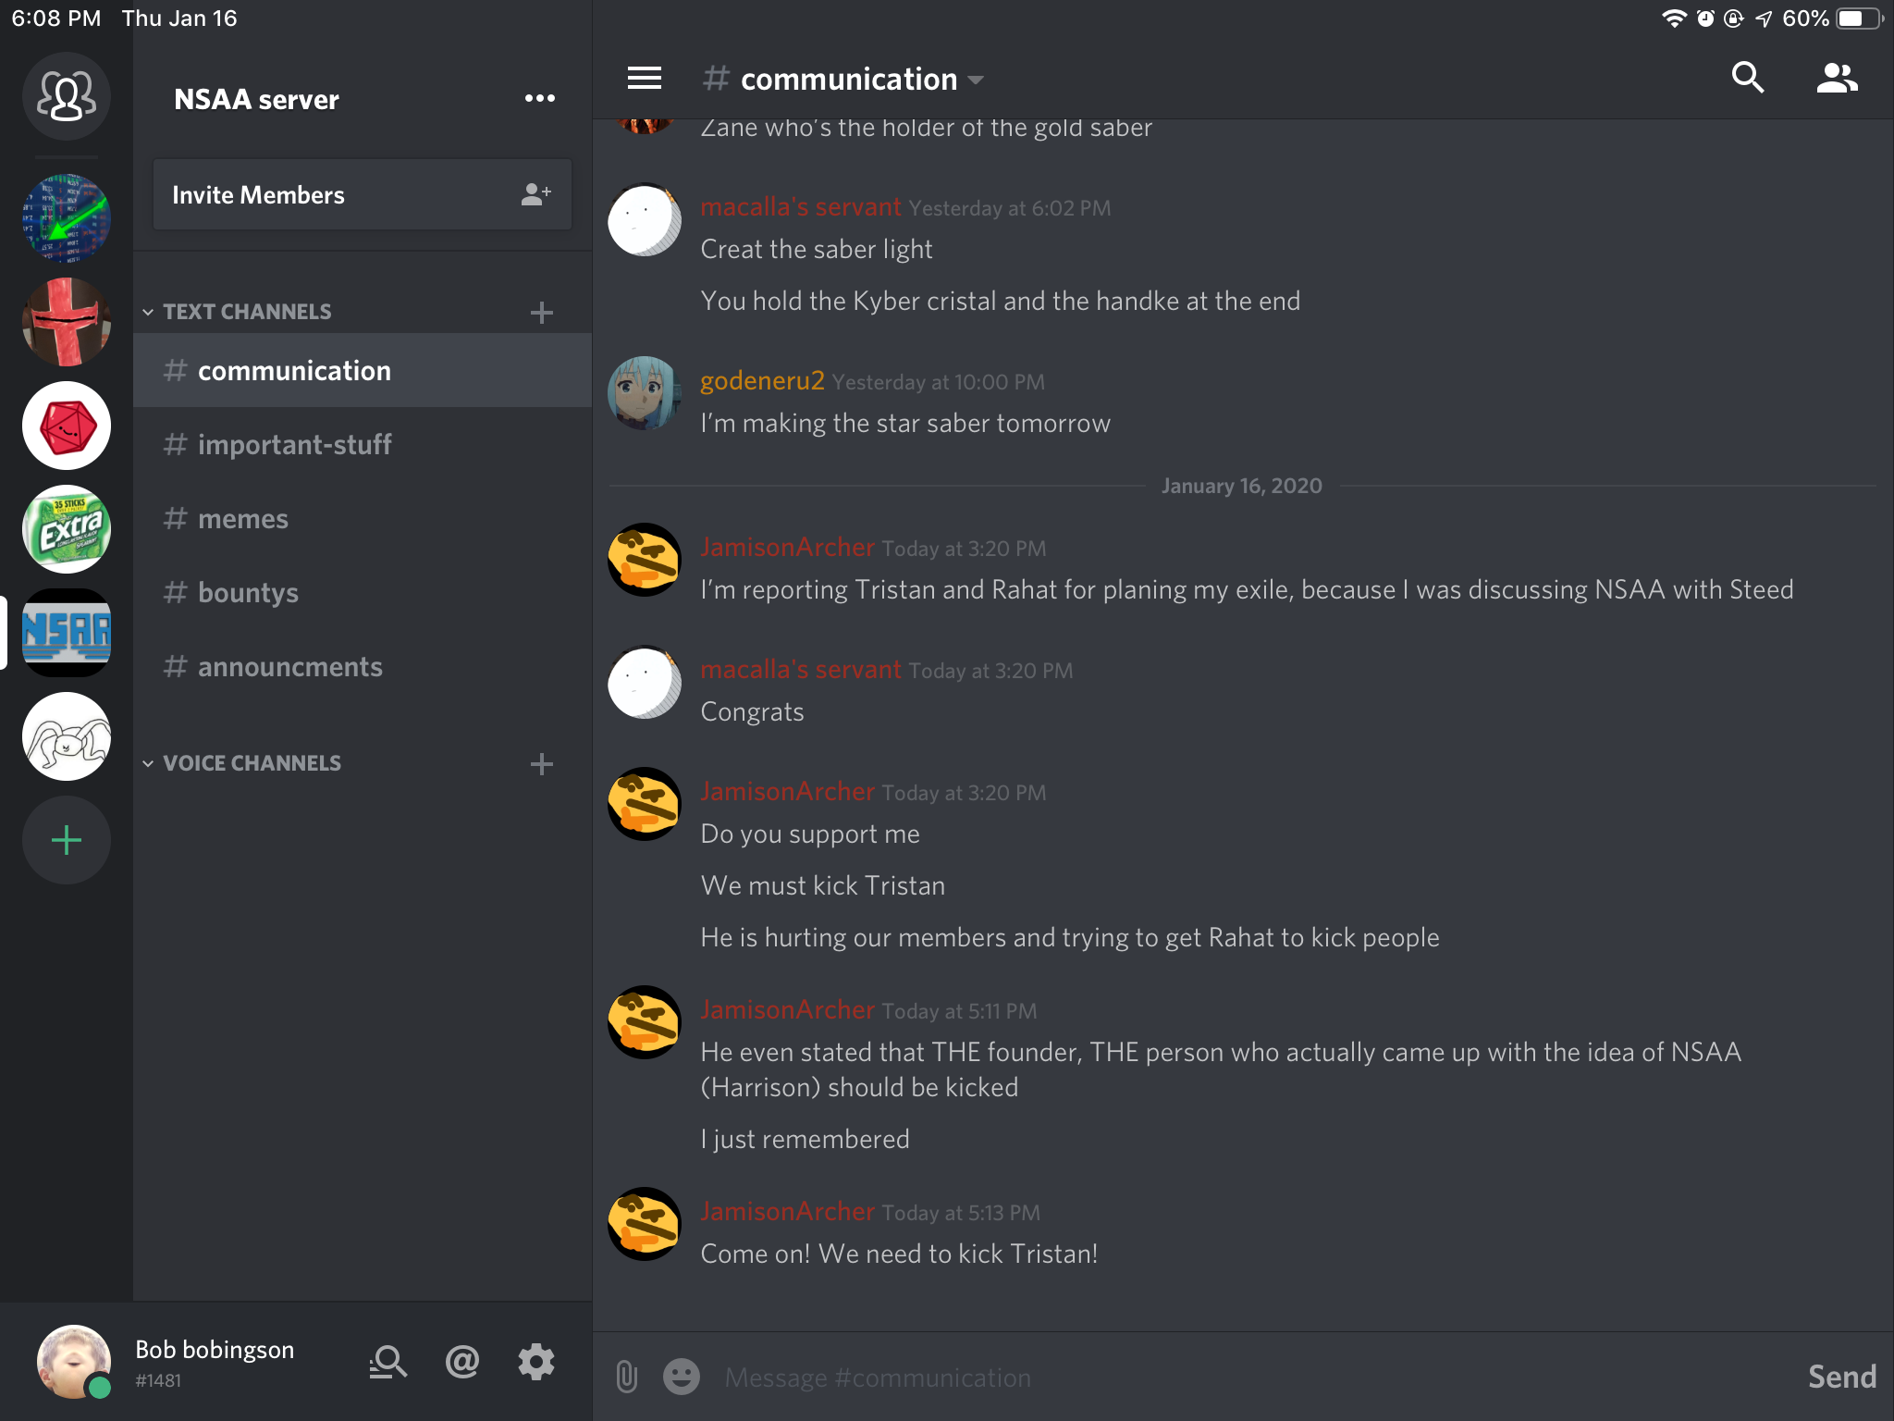
Jan 16 2020
Tyler: 24 wildcash
The Jameson rebellion has begun after he was getting mad at Tristan. He wants to kick general Tristan
Jamison lead the meme channel resistance

Slide 63
Jan 16 2020 meme channel resistance info
The Jamison rebellion has its first casualty. Jamison rebelled and talked in the meme channel. That caused everyone else to talk in the meme channel. The rule now no longer exists due to no one recognizing it. The first casualty of the Jamison rebellion is the no talking in the meme channel rule.

Slide 64
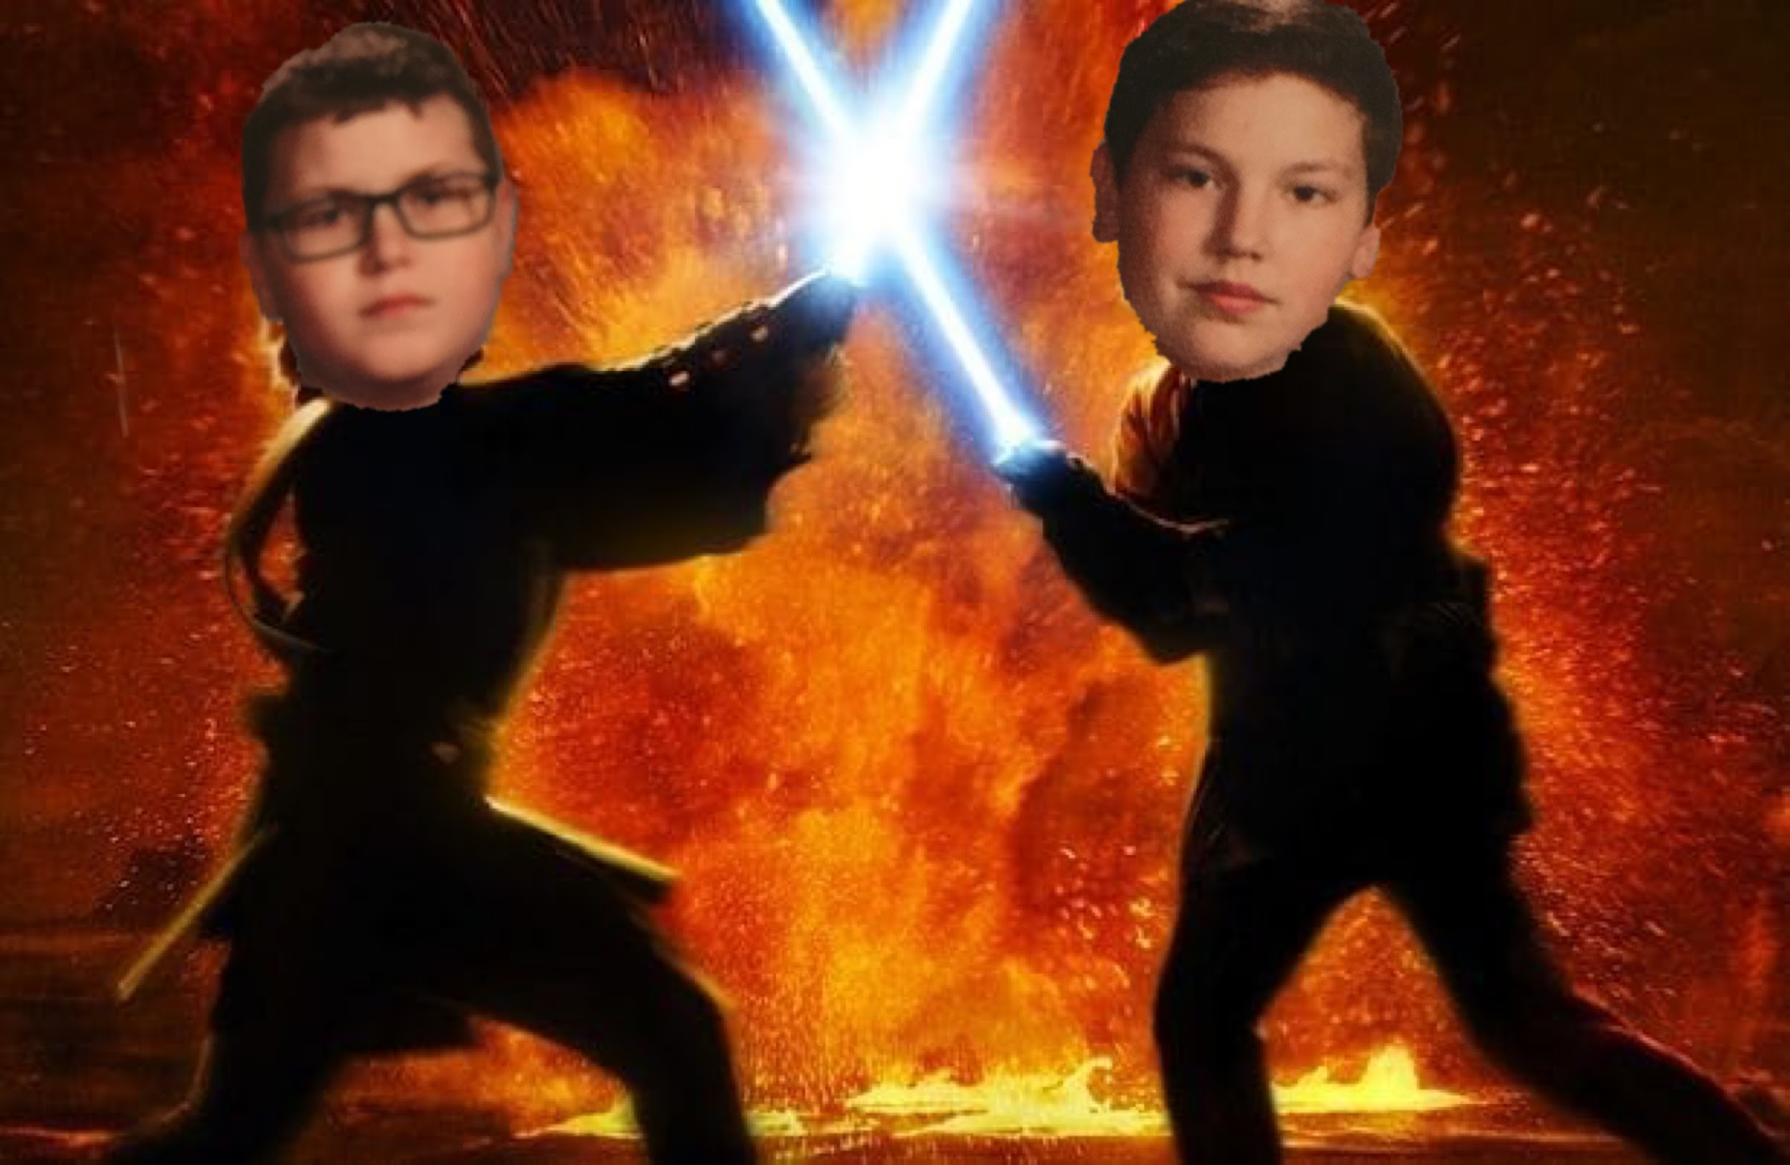
Jan 17 2020
Tristan: 2 wildcash
The Jamison war has begun
Rahat has sided with Tristan. Nick will remain netural.
Zane: 19 wildcash
Collin: 25 wildcash
Tyler: 40 wildcash
Steven: 86 wildcash
Kyrillos: 12 wildcash
The first battle of the Jamison war was the map battle

Slide 65
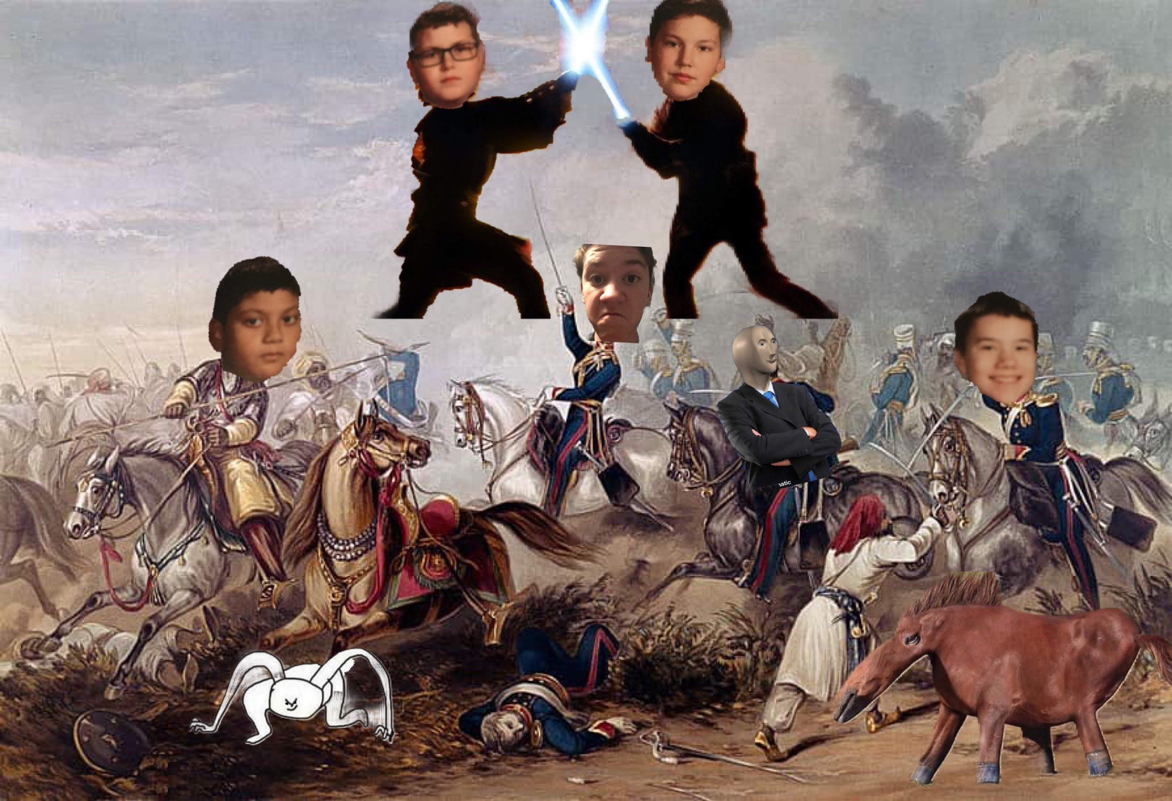
Jan 17 2020 map battle details
Tristan and Jamison were necking each other and decided to settle it with the game of map ball that was happening in P.E. Zane, rahat, and Tristan was on one team. And Jamison and Harrison was on the other team. Jamison’s team won. There are no further implactions of this battle the only thing that was proved is Jamison and Harrison are better at map ball.

Slide 66
Jan 17 2020 other info
Harrison has sided with Jamison
Zane has sided with Tristan

Slide 67
Jan 21 2020
Project expansion was founded by Zane Miller: we will now have a separate museum for cashes from other schools which we collect during this year.
Zane: 5 power tickets, 1 rare blue power ticket, 2 wildcash
Tristan: 19 wildcash, one care cash, 2 campbell cash. One special collections pencil cash
David: 1 wildcash
The Jamison war has ended
Collin: 40 wildcash

Slide 68
Jan 21 2020 Jamison war end
Rahat declared that the Jamison war was over on Jan 20 2020. Jamison will stop trying to ban Tristan as long as Tristan would have the no necking treaty more heavily enforced on him.

Slide 69
Jan 22 2020
Tyler: 3 wildcash
Collin: 6 wildcash
Zane: 3 wildcash
Tristan: 1 wildcash
David: 1 wildcash
Nick:1 wildcash
Project national was an idea created by Zane Miller
After a vote of discord server members project national was rejected

Slide 70
Jan 23 2020
Zane: 4 wildcash
Tristan: 1 wildcash
Collin: 3 wildcash
Steven: 52 wildcash
Operation trash can was started: there is ripped wildcash in trash cans that can be tapped together.
E112’s trash can was scavenged. 12 wildcash was tapped. Zane and Harrison took it and tapped it. 6 was givin to Harrison and six to Zane. Zane gave the 6 wildcash to the community
Ethan: 11 wildcash finally... and was rehired

Slide 71
Jan 24 2020
Tristan: 5 wildcash
Zane: 10 wildcash from a wildcash bundle pack that was found on the floor from scavenging.
Gabe left the NSAA

Slide 72
Jan 27 2020
Zane: one wildcash 2016 - 2017 proud ticket, one golden proud ticket, one sub pround ticket, one epic ownership proud ticket.
Operation RTFDS ( raid the freakin discord server) has been launched. A discord server invite has been found on a sticky note. All members will join the server and spam screenshots of crab rave or rick roll. Zane will take the profile pictures of the people in the enemy server and put the into a order 66 video. Once the video is sent, the raid is over, and we will leave.
Operation RTFDS was completed and was successful.

Slide 73
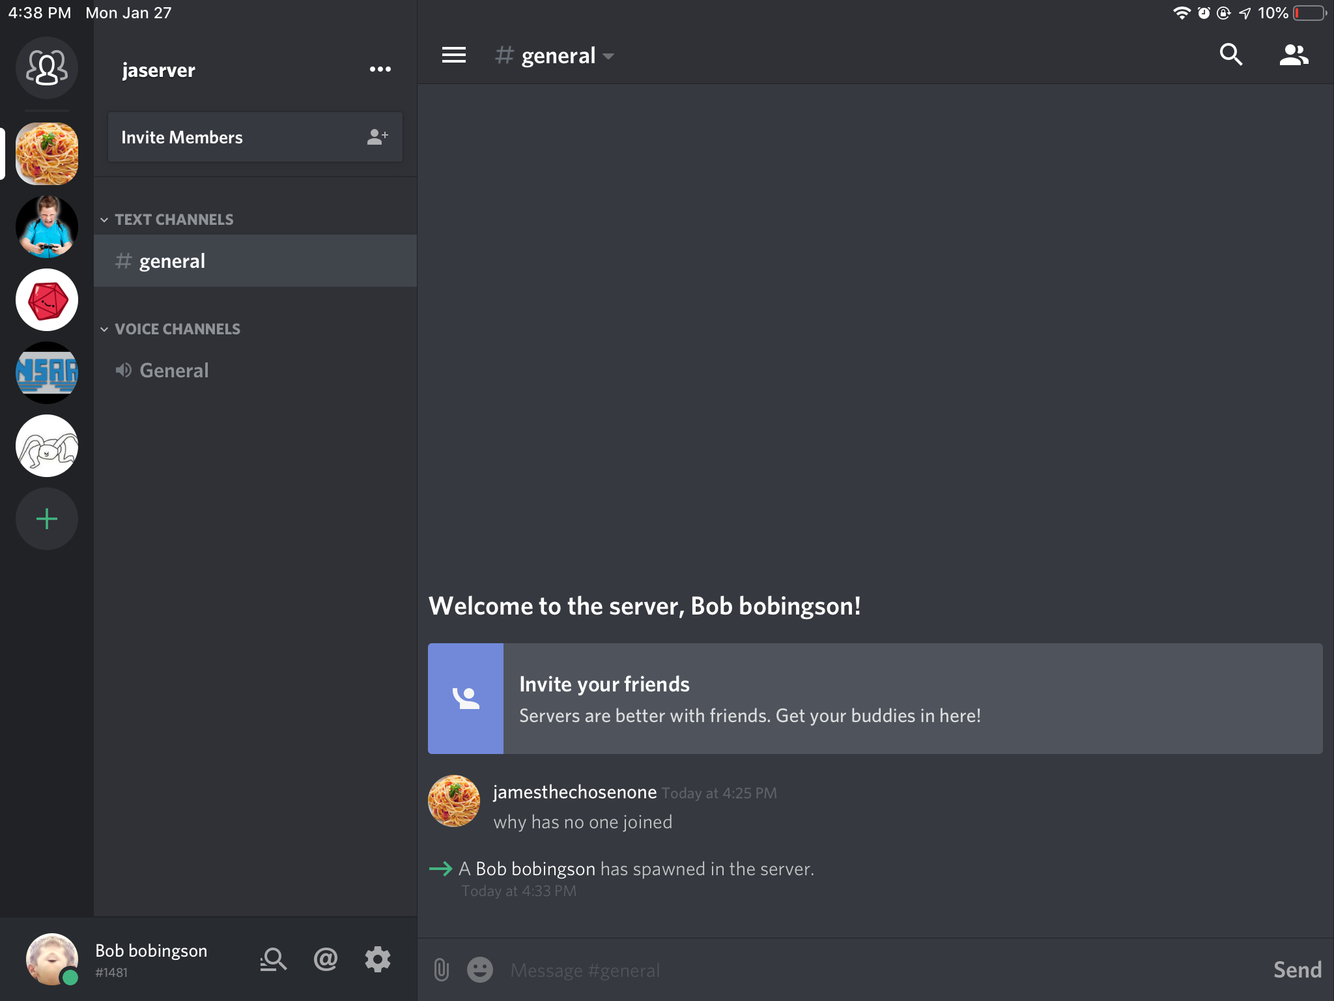
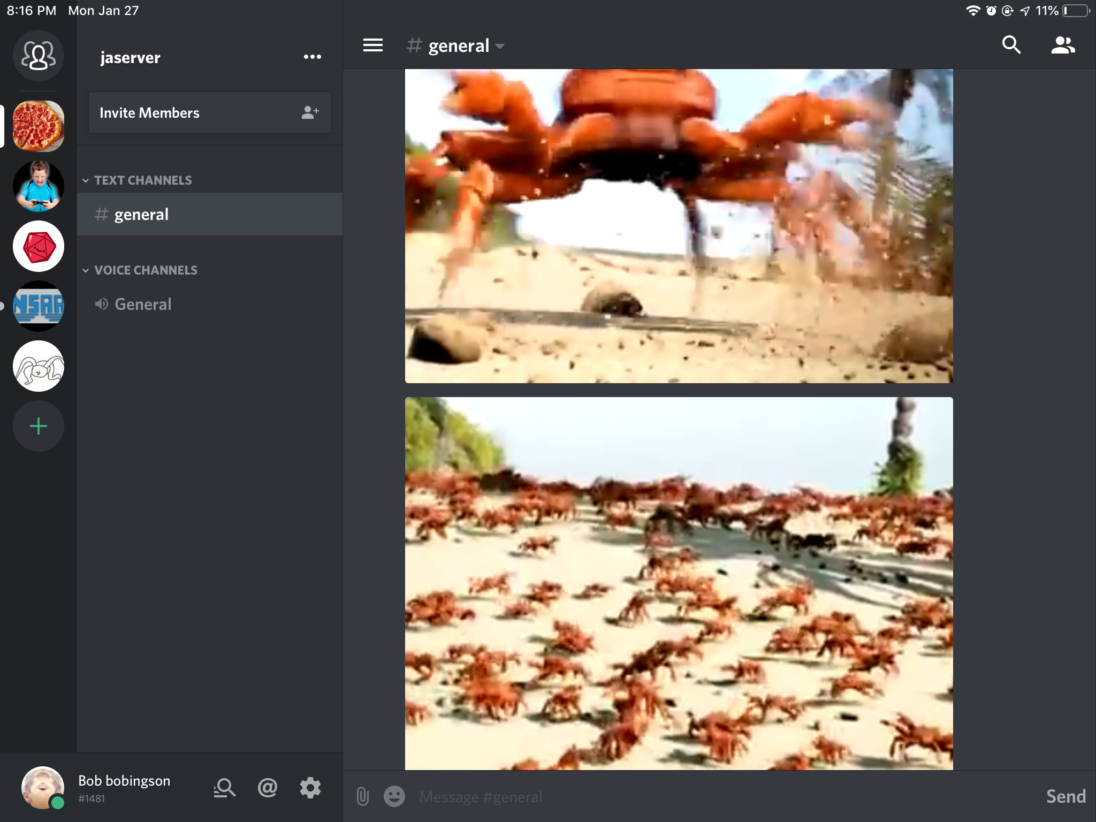
Jan 27 2020 operation RTFDS information
We raided the server at 6:00. Zane Harrison rahat Jamison and Tristan were part of the raid. The raid finished with Zane sending the execute order 66 discord raid video. It was successful and the operation was completed.

Slide 74
Jan 28 2020
Zane: three wildcash
Tyler wants to spend all wildcash now Zane wants to spend it at end of the year

Slide 75
Jan 29 2020
Tyler: 29 wildcash
Zane: 4 wildcash
A new server rule was created
Don't talk about viruses or you will be banned.
Rahat and jamison talked about viruses and were banned for 10 minutes. Jamison rebeled once again and decided not to come back
Jamison left the NSAA

Slide 76
Jan 30 2020
Zane: 3 wildcash
Tyler: 3 wildcash
Collin: 12 wildcash
Jamison started his own company archer incorporated.
Ethan: 7 Campbell cash
Tristan started a lord ytka server worshiping a goose. So did nick.

Slide 77
Jan 31 2020
Zane: 4 wildcash
Collin: 9 wildcash
Tristan: 1 wildcash
10 wildcash was spent on exclusive Andrew antenna
The ytka war has begun
Enterprise incorporated wanted to spend all wildcash now, while NSAA wants to spend it all at the end of the year. A new discord server was founded by Zane Miller that has enterprise incorporated and the national Stonks Association of Aragon. There a vote was started but it will take time to complete
Jamison rejoined the NSAA after his company failed though he still wants Tristan gone.

Slide 78
Jan 31 2020 Ytka war information
On Jan 30 Tristan made a server worshiping Ytka the goose. Nick did also. Now they were arguing on whose server is better and divided the NSAA. Jamison sided with nick. Zane and rahat sided with Tristan but Zane changed forced to side with nick.

Slide 79
Feb 3 2020
Zane: 2 wildcash
Tristan: 7 wildcash
Collin: 39 wildcash
E112’s trash can was scavenged by David. 4 wildcash was found. All was givin to community
Zane created a formal base for raiding discord servers ( within the NSAA but a separate server )called crab server. The Ytka servers thought Zane was trying to worship crabs. Zane got exiled from the nick’s Ytka server.
Tristan rahat and Harrison joined the crab server.

Slide 80
Feb 4 2020
Zane, the co Founder has come up with an idea. Make 10 3 - d triangles with LEGO heads in them. 2 will have blue heads and 8 will have yellow heads. We will sell them for two wildcash. If they get a blue head they win 4 wildcash. If they get a yellow head they get no wildcash.
Nick ended the Ytka army his discord server.
Dean Evan Jeremy and Thomas joined the crab server

Slide 81
Feb 5 2020
Zane: 12 wildcash
The vote results came in and we will spend at the end of the year
Tyler was salty by the results and joined crab server and kicked members and left. Zane decided to raid Tyler’s dnd server ( which he was a part of. ) but only 4 out of Seven people joined. Zane and Evan ( who was part of crab server ) were imprisoned in gay baby jail in Tyler’s dnd server and the other raiders retreated. There weren’t enough people for the raid and the crab server lost.

Slide 82
Feb 6 2020
Operation rainbow cash has been completed by rahat and jarad.
The rainbow cash was added to project special collections. They consist of yellow, dark blue, purple, green, red and orange colored cash
Nick hoppe was rehired after joining the discord server

Slide 83
Feb 7 2020
Zane: 8 wildcash
The constitution 3.0 idea was created by Zane Miller and Harrison Steed to increase profit. The entire NSAA will be reworked during the weekend.
Nick hoppe joined crab server

Slide 84
Weekend info:
The constitution has been updated. Members will now be paid for their duties. There are 6 main roles.
Supplier: paid 5 cash a week, gets supplies for sellers
Salesman: paid 5 cash a week. Make sales for the NSAA
Recruiter: paid 2 wildcash a week, recruits new members to the NSAA.
Business man: paid 3 cash a week. Create business ideas and marketing strategies for the NSAA
Investor: donate wildcash to the NSAA can be on top of any other role.
Expansion cash hunter: paid 2 wildcash a week. Hunts expansion cash.

Slide 85
Weekend info part two
Zane’s role was updated to supplier
Tristan’s role was updated to expansion cash hunter and investor
Harrison’s role was updated to supplier
Nick’s role was updated to business man
Jamison’s role was updated to salesman
Rahat’s role was updated to salesman
Jonah was fired
David’s role was updated to investor
Ethan’s role was updated to investor

Slide 86
Weekend info part three
Jarad’s role was updated to supplier
2 wildcash was spent to create the aluminum cash for project special collections.
Rahat has started construction in the end of the year wildcash musium
Rahat’s roles has been updated to sales person and NSAA community item holder
Zane has been given the investor role

Slide 87
February 10 2020
Tristan: 2 wildcash
Zane: 12 wildcash
Harrison: 1 wildcash
Nick: 2 counter cash
Kyrillos was hired and he left enterprise incorporated as a salesman

Slide 88
Feb 11 2020
Zane started renting out his infinity cube for one wildcash for one minute and made 6 wildcash from this business idea
Collin: 8 wildcash

Slide 89
February 12 2020
Zane: 4 wildcash
Steven: 56 wildcash
Nick wants Tristan to delete his Ytka server to end the war but Tristan refuseses

Slide 90
February 13 2020
Tristan: 4 wildcash
Tristan banned nick from the NSAA discord server after nick kept telling him to delete his Ytka server nick was unbaned by Zane.
Zane: 8 wildcash
Collin: 53 wildcash
Kyrillos: 16 wildcash
The hydration wars have begun
Bryson joined the crab server

Slide 91
Feb 13 hydration Wars info
Nick hoppe started stealing Zane’s hydration. Soon multiple people started stealing zane’s hydration. After a while the people split into two factions the joke stealers and the permanent stealers. Joke stealers took the hydration and then gave it back. They were lead by nick hoppe and consisted of nick hoppe, harrison, Collin. Permanent stealers were fiercely lead by josh and consisted of josh, pierce, Nathan and Andrew. The groups always tried to steal Zane’s hydration. Zane was good at defending it but with all the people trying to steal it Zane rarely finished the day with it.

Slide 92
Feb 14 2020
Zane: 4 wildcash
Kyrillos: 8 wildcash
Tristan: 12 wildcash
Collin: 42 wildcash
Kyrillos was paid 5 wildcash
Jamison was paid 5 wildcash
Jarad was paid 5 wildcash
Nick was paid 3 wildcash
Jamison: a dark blue cash

Slide 93
Feb 18 2020
Zane: 12 wildcash
Tristan: 7 wildcash
Kyrillos: 6 wildcash
Zane miller started operation chip cash to create chip cash for project special collections.
Zane made the Cheeto cash

Slide 94
Feb 19 2020
Tristan: 1 wildcash
Zane: 13 wildcash
Nick: 21 wildcash
Tristan has the idea to add extra roles within the server of the NSAA. Every 10 wildcash you donate gives you an extra permission in the NSAA discord server itself
Kaleb was hired by Tristan
The trades and bounties channel was started in the NSAA discord server so members could trade items and put wildcash bounties on things.

Slide 95
Feb 20 2020
Tristan: 3 wildcash
Andrew: 1 wildcash
Nick: 8 wildcash
Zane: 2 wildcash
Bryson was rehired by tristan
Chase was hired by Tristan.
Jayden was hired by Tristan
Zane made the SunChips cash for special collections
Jamison left the NSAA

Slide 96
Feb 21 2020
Tristan: 77 wildcash
Zane: 7 wildcash
Collin: 43 wildcash
David: 2 wildcash
Kyrillos was paid 5 wildcash
Jarad was paid 5 wildcash
Kyrillos: 3 wildcash
Nick gave his 3 wildcash payment to us.

Slide 97
Feb 24 2020
Collin: 12 wildcash
Zane: 7 wildcash
Zane has founded the N.I.L (NSAA information log) it’s purpose is to conduct surveys or wildcash using students to find how to improve sales. And it uses secret agents to find out the information on the other companies.
Zane’s role is now supplier and N.I.L agent.
The N.I.L agent Zane found new information. Last year there was another company called emporium. It was lead by sherkoni, founded in August, had 500 wildcash and was closed in December of last year. Nothing else is known.

Slide 98
Feb 25 2020
Zane: 5 wildcash
Tristan: 50 wildcash
Nick: 34 wildcash

Slide 99
Feb 26 2020
Zane: 5 wildcash
Collin: 24 wildcash
Kyrillos: 2 wildcash
Nick: 46 wildcash
Nick was promoted to general

Slide 100
Feb 27 2020
Tristan: 4 wildcash
Zane: 1 wildcash
Rahat: 17 wildcash
Kaleb’s role was updated to supplier
Bryson’s role was updated to supplier
Nick hoppe’s role was updated to business man

Slide 101
Feb 28 2020
Tristan: 2 wildcash
Harrison: 3 wildcash
Zane: 1 wildcash
Nick hoppe was paid 3 wildcash
Nick gave is 3 wildcash payment
Kyrillos was paid 5 wildcash
Jarad was paid 5 wildcash
Kaleb was paid 5 wildcash
The battle of E243 happened.

Slide 102
Feb 28 2020 battle of E243
Josh stole Zane’s hydration and passed it to a couple of permanent stealers. It was then given back to josh. Nick hoppe wanted it and pushed josh into demah.

Slide 103
Mar 2 2020
Tristan: 2 wildcash
Zane: 3 wildcash

Slide 104
Mar 3 2020
Tristan: 2 wildcash
Zane: 2 wildcash
Rahat: 8 wildcash

Slide 105
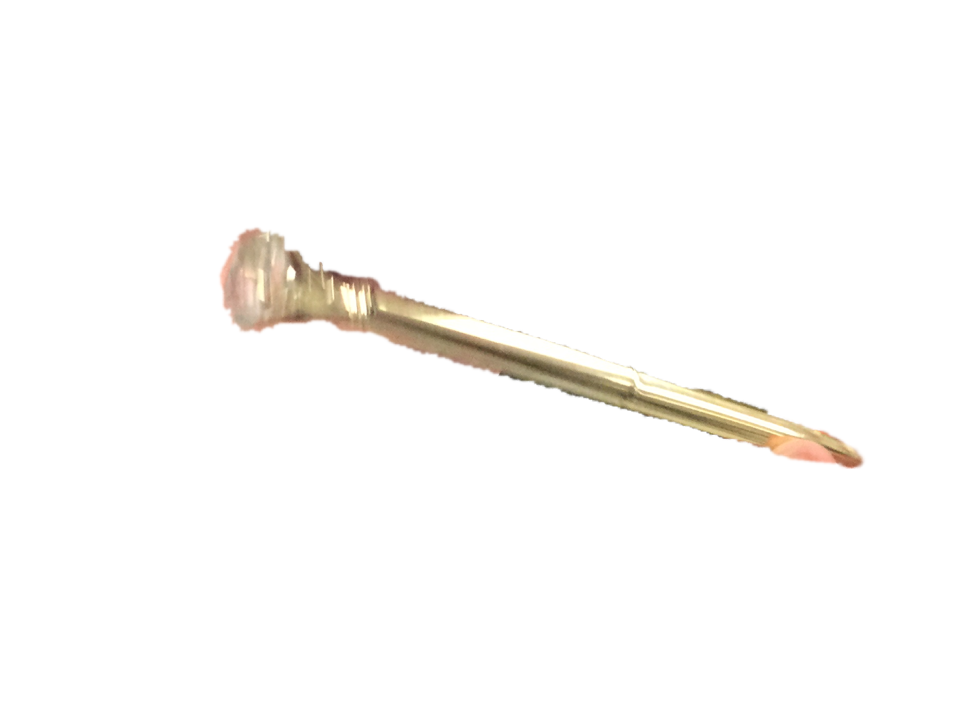
Mar 4 2020
Zane: 6 wildcash
The NSAA scavenger log has started.
The business man nick has created the business idea to sell Nono word passes for wildcash
Evan found an artifact pen

Slide 106
Mar 5 2020
Zane: 1 wildcash
Kyrillos: 3 wildcash

Slide 107
Mar 6 2020
Zane: 3 wildcash
Nick was paid three wildcash and gave it back to the community
Nick hoppe was paid 3 wildcash
Jarad was paid 5 wildcash
Kaleb was fired
Kyrillos was paid 5 wildcash
David: 5 wildcash
Spring break started

Slide 108
Mar 8th 2020
Zane created the decontamination proclamation to stop germs spreading from scavenged items.
The co founder rank was renamed to co owner. Zane and Harrison were the two co founders and Zane and Harrison and rahat are the three co owners.

Slide 109
Mar 13th 2020
School got closed for an extra week
The age of Stinks has begun

Slide 110
Mar 16th 2020
School got closed until April 9th
Zane declared a state of emergency for the NSAA

Slide 111
March 26th 2020
Even though school is closed the NSAA has had a lot of time to stay busy and to reflect on the company. Edgenuity is the online learning system that the district assigned the students. It was so bad that most of the NSAA united against it. Zane miller started the edgenuity is bad bureau. He started writing an article saying how bad edgenuity is.

Slide 112
March 30th, 2020
Each co owner got a specialized position to help balance power. Zane got CCO. Chief creative officer. He makes constitutional ideas. He also has control over the wildcash. Rahat got COO. Chief operating officer. He supervises the employees and passes constitutional ideas. He also is the judge in courthouse cases such as demotion and firing. Harrison got CEO. Chief executive officer. He puts constitutional ideas into the NSAA and applies the NSAA into the school.

Slide 113
March 31st 2020
Courthouse channel of the NSAA server was made.
Due to a lack of servers to raid and most people giving up crab server has shut down.

Slide 114
April 1st 2020
The article about edgenuity was finished.
Zane miller and Harrison stead started looking for quotes all across Aragon about edgenuity’s unhelpfulness to backup their claims.

Slide 115
April 2nd 2020
With school canceled trading closed because the NSAA members can’t meet outside of school.

Slide 116
April 3rd/20
Rahat Hasan created the idea to have holidays in the NSAA.
Christmas sale December 24 - December 26. Every item is half off.
End of the year day. Last day of school all employees get a pen and any specialty badges.
Jamison war Memorial Day. January 16th. All NSAA employees remember the Jamison war.
Zane miller created specialty badges within the NSAA. All members get a ranking badge but badges of honor are given on the last day of school for special achievements. They have top wildcash producer. Co founder. Most valued member. Largest single donation. Best specialty cash producer.
The edgenuity war has begun.

Slide 117
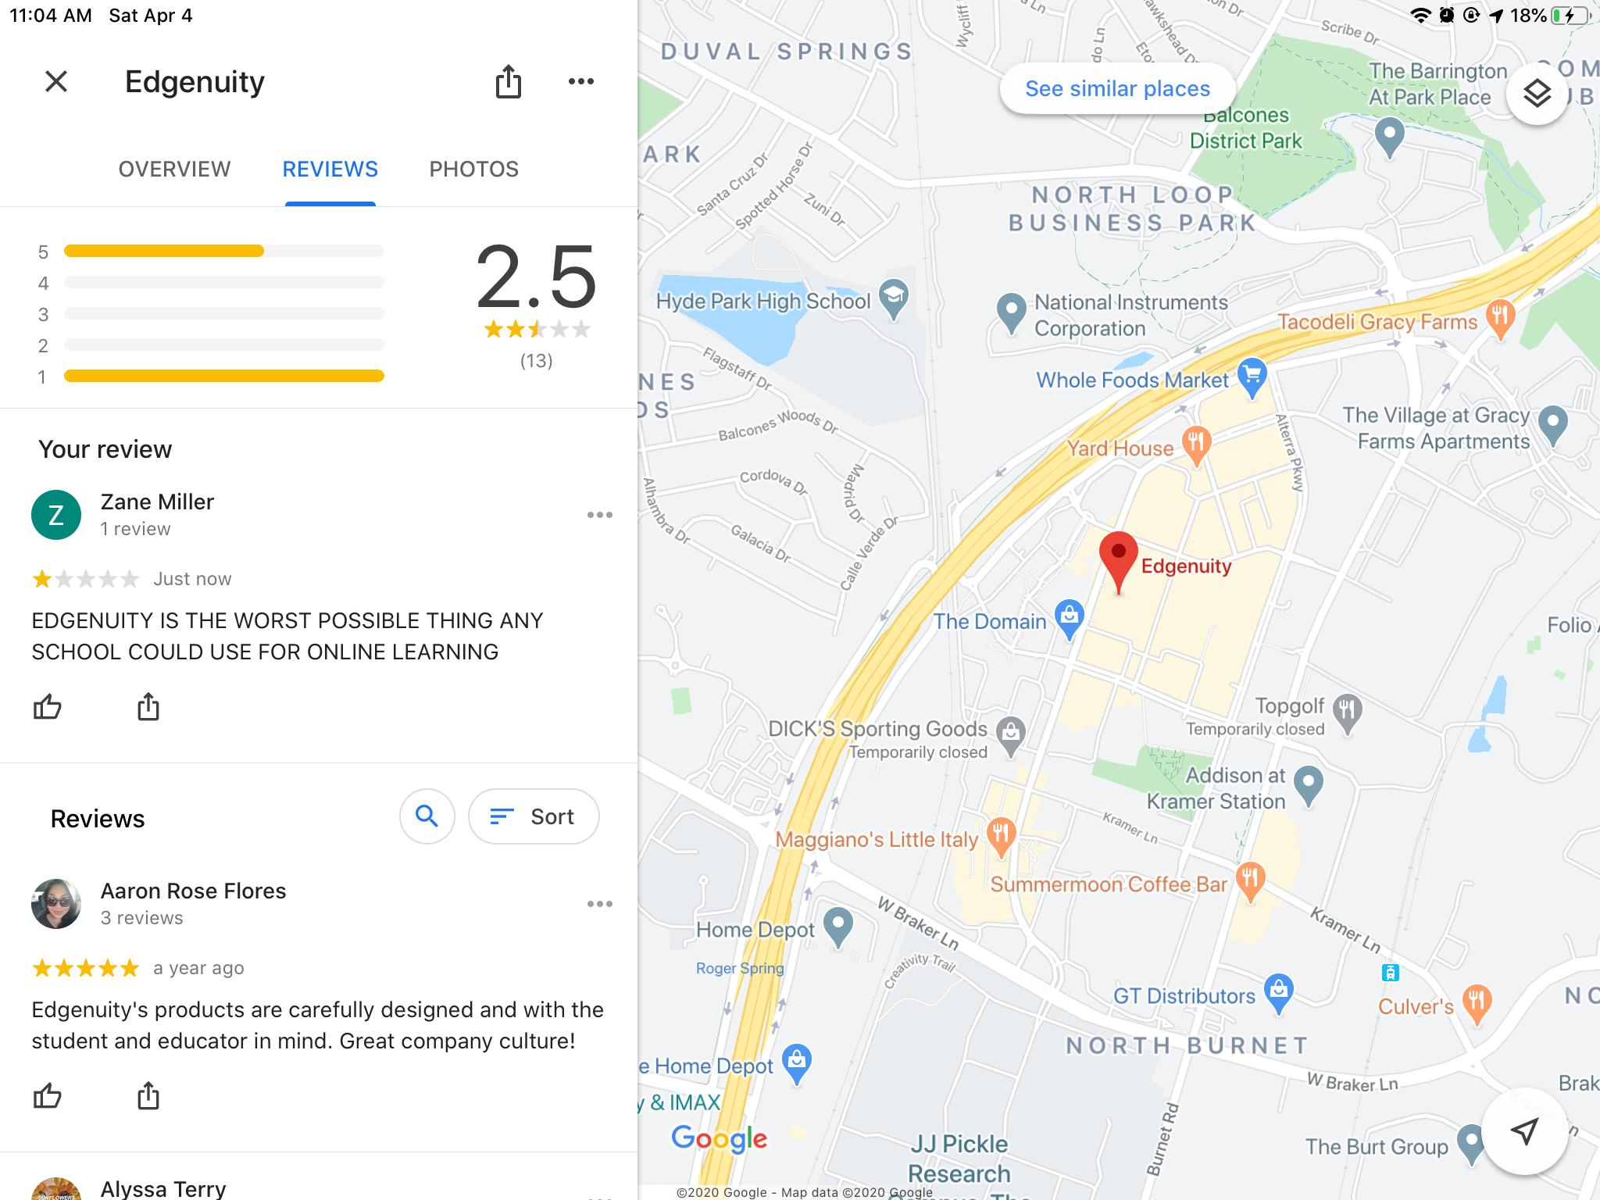
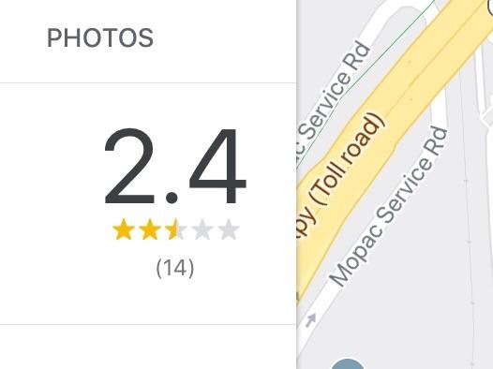
April 4 2020
Zane Miller led the bad rating campaign against edgenuity. He used 5 alternate accounts to give edgenuity’s headquarters one star ratings. It brought its rating down from 2.5 stars to 2.4 stars

Slide 118
April 5th 2020
After a vote the NSAA has decided that if there are ever 4 co owners the fourth co owner will get the position of CFO. Chief financial officer. The CFO does not have to possess the wildcash but if any co owner has an idea of a way to spend the wildcash it must be passed by the CFO. If there are three co owners the position goes to the CCO. If there are two co owners the CCO and CEO positions are combined and the COO gets the role of the CFO. The power of control over the wildcash was transferred from the CCO to the CFO.

Slide 119
April 6th 2020
Edgenuity fought back and added a new tech course. This increased the number of classes for most students from 4 to 5 and the class also used useless material and was extra long to make it less enjoyable.

Slide 120
April 10th 2020
After the meme channel rebellion the meme channel never recovered. All the talking and videos and random spamming destroyed it once the members were allowed to talk in it. After awhile it was barely even used for memes even more. Zane miller and Harrison stead decided to rename it to the funny channel.

Slide 121
April 13th 2020
Edgenuity gave the teachers access to the progress of the students on edgenuity. They hit the NSAA twice. We started losing.

Slide 122
April 15th 2020
Project linkpen was started. A duo of pens with the link tinycc/Linkpen on it will be created by June 6th. The link can lead to anything. It will lead to the NSAA website but will be changed.

